Slide 1
Chapter 1: The Introduction to Database

Slide 2
Learning Outcomes
At the end of this chapter, students will be able to:
Define the key terms: data and information.
Name several examples of database applications.
Describe the traditional file-based systems
Describe the database approach & the components

Slide 3
Definitions
Data: Meaningful facts, text, graphics, images, sound, video segments
Information: Data processed to be useful in decision making
Database: An organized collection of logically related data
Metadata: Data that describes data

Slide 4
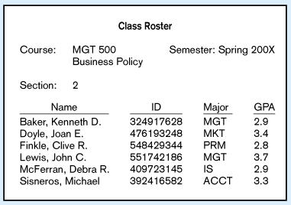
Figure 1-1a Data in Context
Large volume of facts, difficult to interpret or make decisions based on

Slide 5
Figure 1-1b Summarized data
Useful information that managers can use for decision making and interpretation

Slide 6
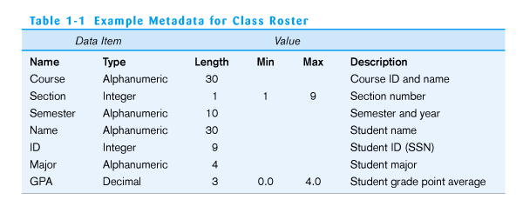
Table 1-1 Metadata
Descriptions of the properties or characteristics of the data, including data types, field sizes, allowable values, and documentation

Slide 7
Examples of Database Applications
Purchases from the supermarket
Purchases using your credit card
Booking a holiday at the travel agents
Using the local library
Studying at university

Slide 8
File-Based Systems
Collection of application programs that perform services for the end users (e.g. reports).
Each program defines and manages its own data.

Slide 9
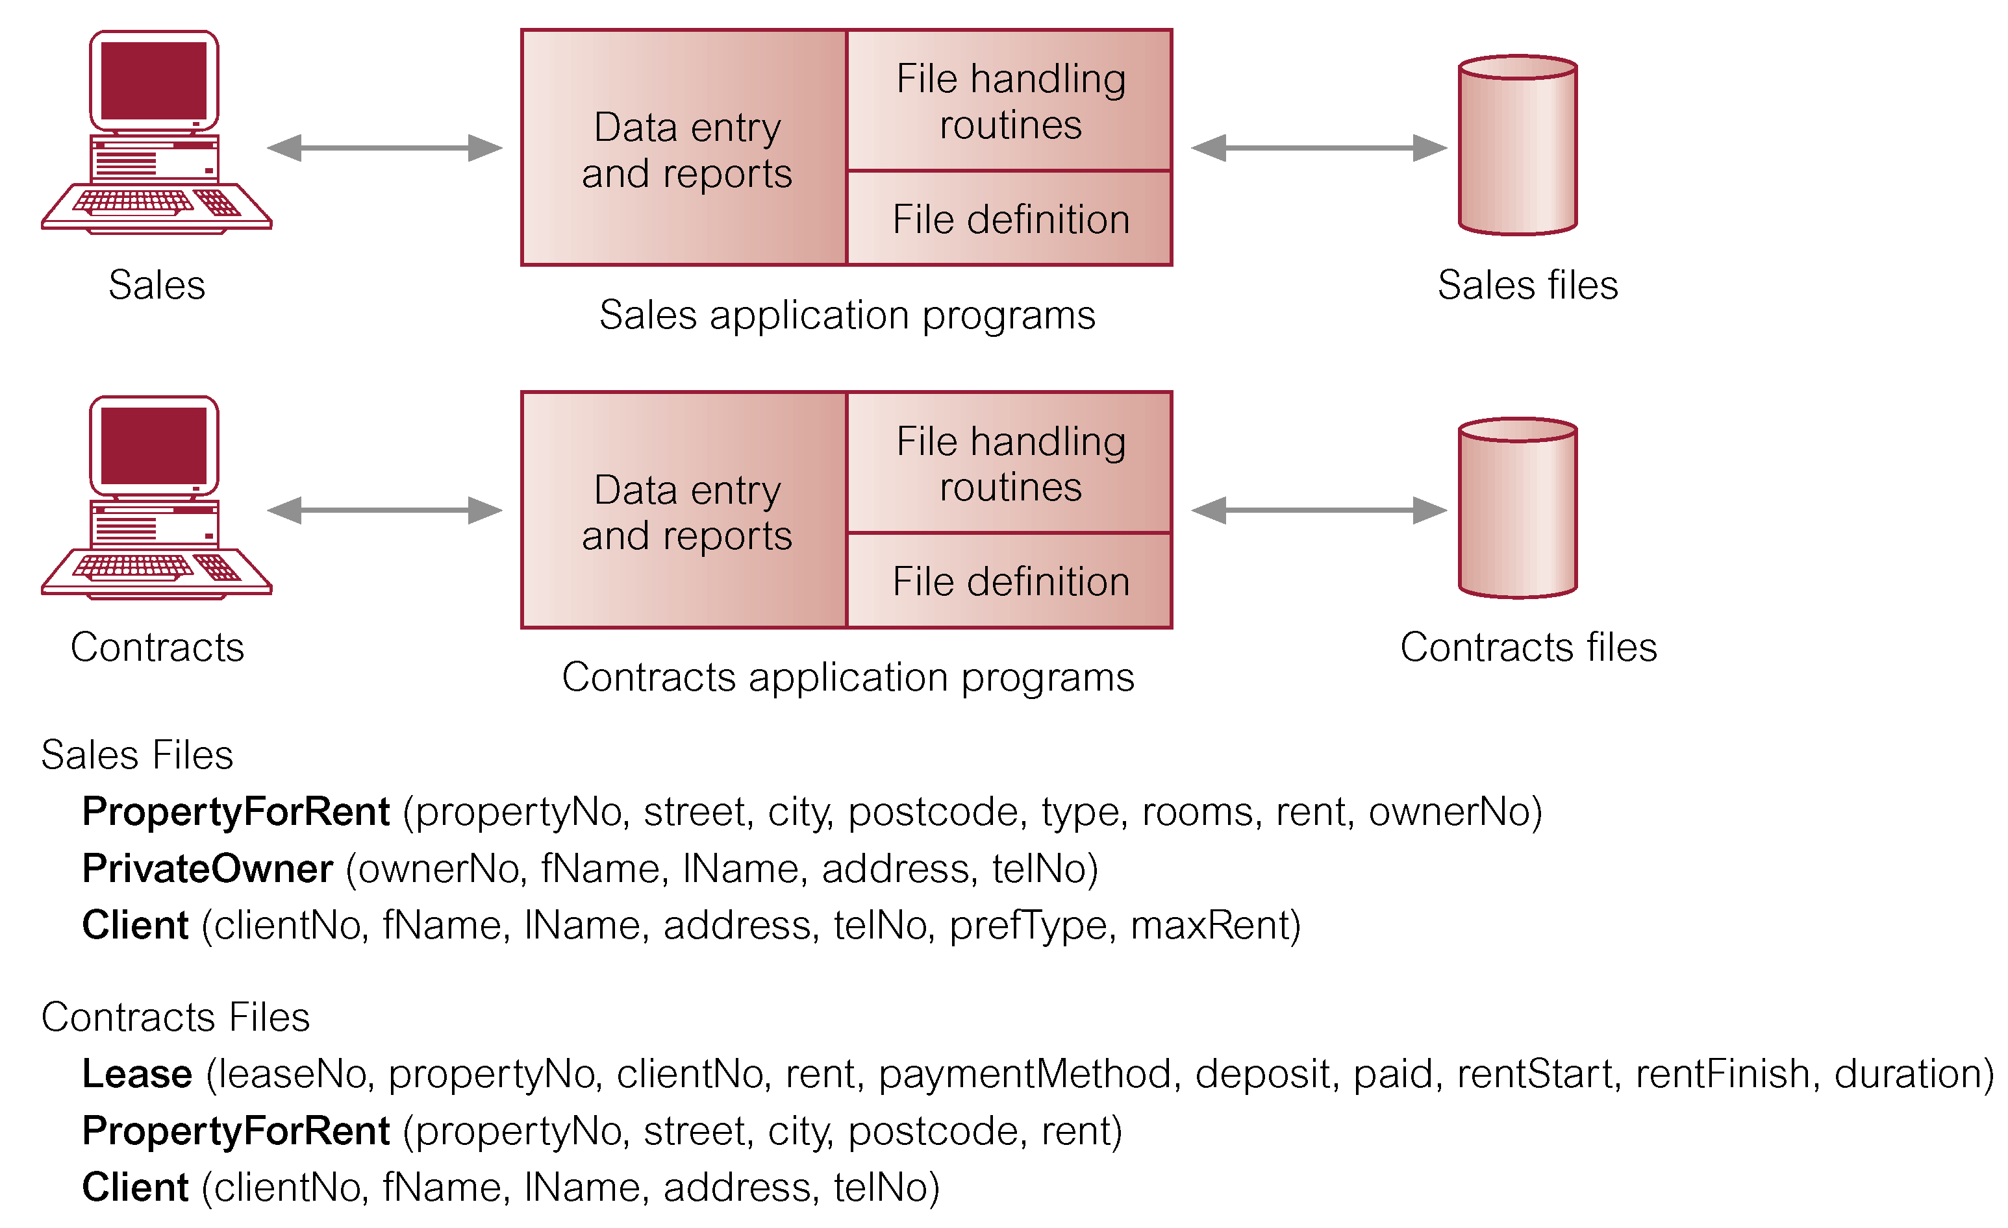
File-Based Processing

Slide 10
Limitations of File-Based Approach
Separation and isolation of data
Each program maintains its own set of data.
Users of one program may be unaware of potentially useful data held by other programs.
Duplication of data
Same data is held by different programs.
Wasted space and potentially different values and/or different formats for the same item.

Slide 11
Limitations of File-based Systems
Program must implement
Security
Concurrency control
Support for schema reorganization
Performance enhancing data structures, e.g., indexes
Observation
Many applications need these services
Solution
Build and sell a software system to provide services!

Slide 12
Database Approach
Arose because:
Definition of data was embedded in application programs, rather than being stored separately and independently.
No control over access and manipulation of data beyond that imposed by application programs.
Result:
the database and Database Management System (DBMS).

Slide 13
Database
Shared collection of logically related data (and a description of this data), designed to meet the information needs of an organization.
System catalogue (metadata) provides description of data to enable program–data independence.
Logically related data comprises entities, attributes, and relationships of an organization’s information.

Slide 14
Database Management System (DBMS)
A software system that enables users to define, create, and maintain the database and that provides controlled access to the database.

Slide 15
Database Management System
Application
#1
DBMS
Application
#2
Database
containing
centralized
shared data
Application
#3
DBMS manages data resources like an operating system manages hardware resources

Slide 16
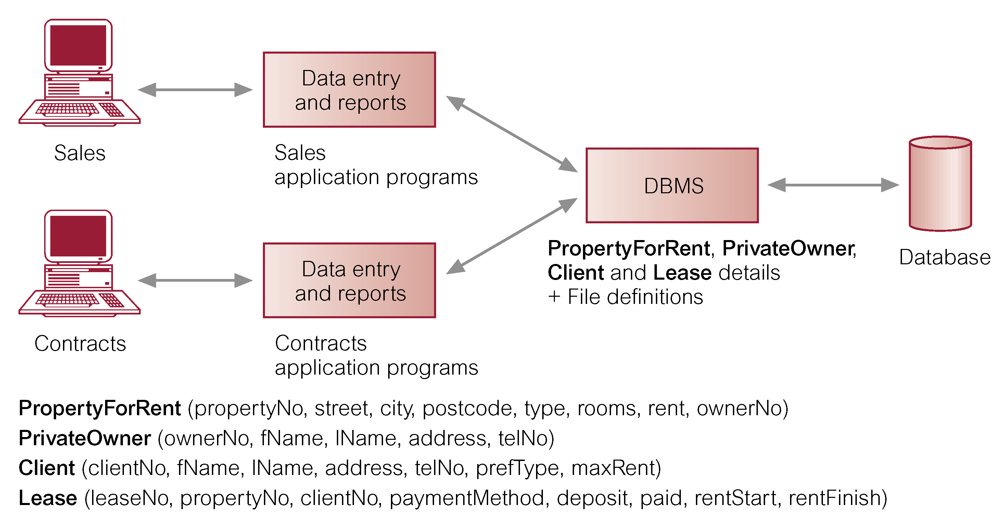
Cont……

Slide 17
Database Approach - facilities
Data definition language (DDL).
Permits specification of data types, structures and any data constraints.
All specifications are stored in the database.
Data manipulation language (DML).
General enquiry facility (query language) of the data.

Slide 18
Cont……
Controlled access to database may include:
A security system.
An integrity system.
A concurrency control system.
A recovery control system.
A user-accessible catalogue.
A view mechanism
Provides users with only the data they want or need to use.

Slide 19
Views
Allows each user to have his or her own view of the database.
A view is essentially some subset of the database.

Slide 20
Cont……
Benefits include:
Reduce complexity;
Provide a level of security;
Provide a mechanism to customize the appearance of the database;
Present a consistent, unchanging picture of the structure of the database, even if the underlying database is changed.

Slide 21
Components of the Database Environment
CASE Tools – computer-aided software engineering
Repository – centralized storehouse of metadata
Database Management System (DBMS) – software for managing the database
Database – storehouse of the data
Application Programs – software using the data
User Interface – text and graphical displays to users
Data Administrators – personnel responsible for maintaining the database
System Developers – personnel responsible for designing databases and software
End Users – people who use the applications and databases

Slide 22
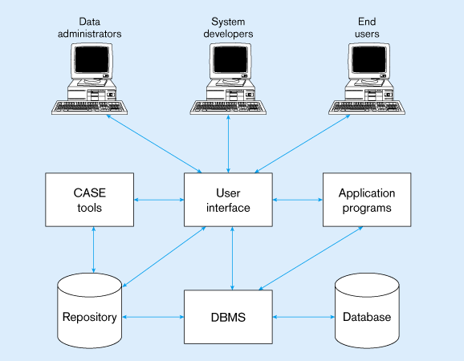
Figure 1-10 Components of the database environment

Slide 23
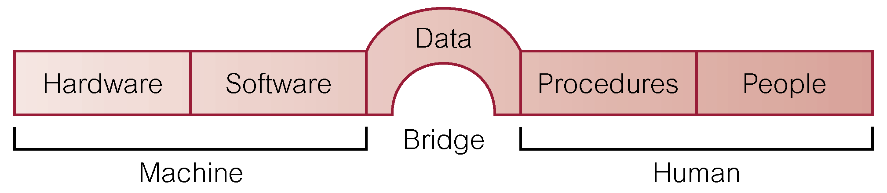
Components of DBMS Environment

Slide 24
Cont……
Hardware
Can range from a PC to a network of computers.
Software
DBMS, operating system, network software (if necessary) and also the application programs.
Data
Used by the organization and a description of this data called the schema.

Slide 25
Cont……
Procedures
Instructions and rules that should be applied to the design and use of the database and DBMS.
People

Slide 26
The Range of Database Applications
Personal Database – standalone desktop database
Workgroup Database – local area network (<25 users)
Department Database – local area network (25-100 users)
Enterprise Database – wide-area network (hundreds or thousands of users)

Slide 27
Personal Database
Widely used because they can often improve personal productivity.
A risk: the data – not easily be shared with other user
Eg: phone book, customer record.

Slide 28
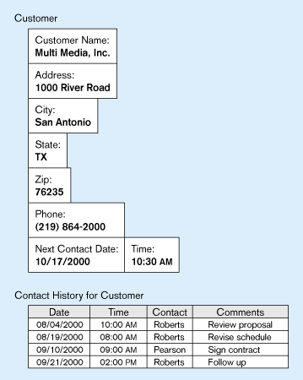
Figure 1-7 Typical data from a personal computer database

Slide 29
Workgroup Database
Shared data among the workgroup members
The risk: when they exist several different workgroup; sharing data cannot be done to all workgroup.

Slide 30
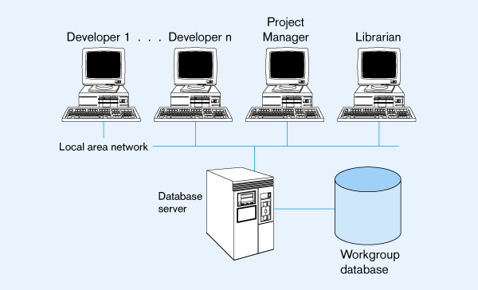
Figure 1-8 Workgroup database with local area network

Slide 31
Department Database
Functional unit within an organization.
Design to support the various function and activities of a department
Eg: personnel, marketing, manufacturing

Slide 32
Enterprise Database
Scope entire organization
Support information needs from many department
Two major development:
Enterprise resources planning (ERP) systems
Data warehousing implementations
Various operational databases.

Slide 33
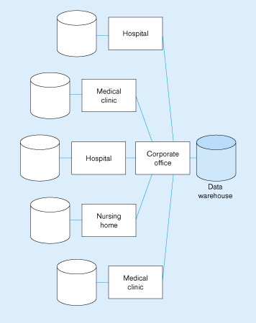
Figure 1-9 An enterprise data warehouse

Slide 34
Evolution of DB Systems
Flat files - 1960s - 1980s
Hierarchical – 1970s - 1990s
Network – 1970s - 1990s
Relational – 1980s - present
Object-oriented – 1990s - present
Object-relational – 1990s - present
Data warehousing – 1980s - present
Web-enabled – 1990s - present

Slide 35
END OF CHAPTER 1

